Slide 1

Revolution Ct
Hyperdrive for
Pediatric Patients

Slide 2
Revolution CT has a feature called hyperdrive installed on our pediatric protocols.
Hyperdrive is exactly as it sounds; it drives the CT couch extremely fast.
This feature is enabled on the scouts (200mm/sec), as well as on our helical scan acquisition.
This couch speed can surprise anyone assisting the patient.

Slide 3
When scanning pediatric patients, do not place trauma plastic underneath the patient. (This applies to any scanner not just revolution CT)
It is too slippery, and allows for the patients to easily slide up or down the couch in the z-direction.
If the patient is moved from their original scout’s ZERO position, ANATOMY WILL BE MISSED.
The GE Slicker is less slippery and should alleviate this issue.

Slide 4
warn those assisting the Pediatric patient with their CT scan of Hyperdrive.
Communication with those assisting the pediatric patient is key to success.

Slide 5
The combination of couch speed, parents/nurses holding onto the non-sedated patient’s arms, and trauma plastic under the patient creates the perfect scenario for the pediatric patient to slide up or down on the CT couch.

Slide 6
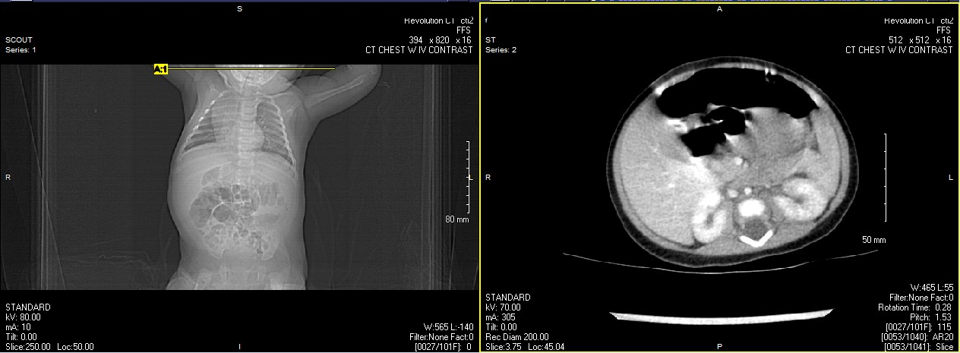
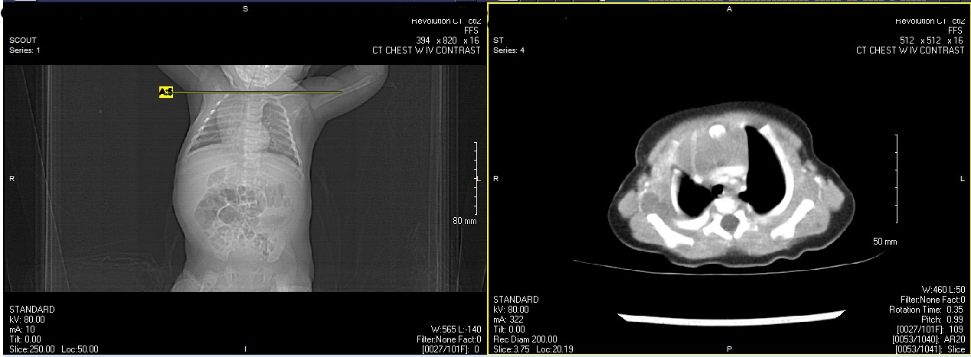
This patient has moved drastically superior in the z-axis from the scout position.
This patient was scanned twice attempting to cover the chest with IV contrast. This patient had to be rescheduled to attempt again.

Slide 7
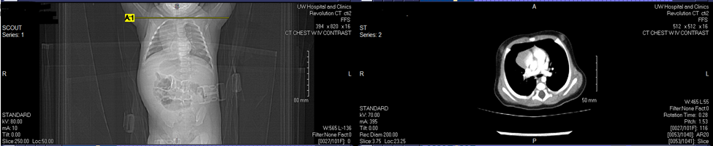
When the patient came back, the exact same issue occurred in which the patient slid up the table after the scout.
Half of the targeted anatomy was missed, and the patient had to be re-scanned yet again.

Slide 8
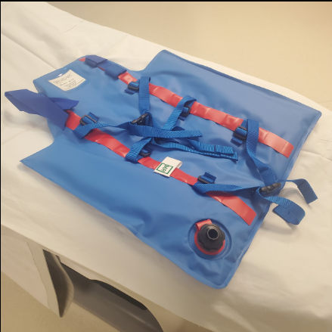
MED-VAC Child Immobilizer devices will help restrict motion.
Removing trauma plastic as well as using a Med-Vac/papoose will help reduce radiation dose by decreasing repeat CT scans due to motion and/or missed anatomy.

