Slide 1
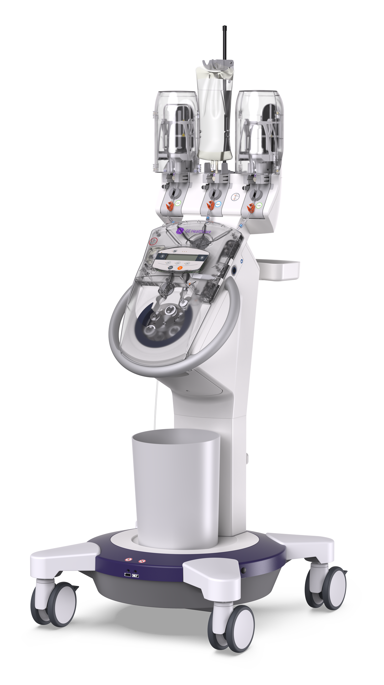

Software 7.0 Application Training
Notes:
Welcome to the CT motion Software 7.0 Application Training. In this video, we’ll walk through the newest features and improvements designed to enhance clinical workflows.

Slide 2
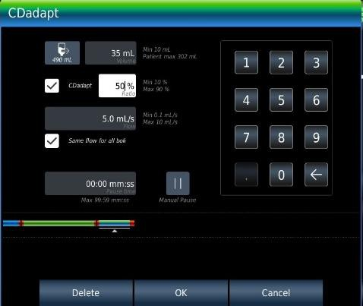
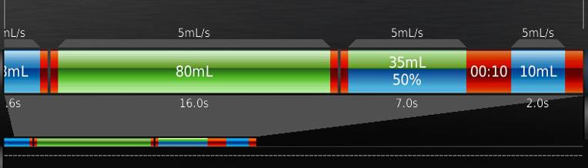
Contrast density reduction: SW option "CDadapt"
  CDadapt reduces the CM concentration of a CM bolus by injecting sequential boli of CM and NaCl.
  Percentage ratio between CM and NaCl can be controlled in the range of 10–90% (increments 1%).
NEW for USA
Notes:
One of the key new features in Software 7.0 is the CDadapt option.
CDadapt reduces contrast‑media concentration by injecting sequential boluses of contrast and saline.
Users can customize the ratio of contrast to saline from 10% to 90%, adjustable in one‑percent increments.
This provides greater flexibility in managing contrast density for a range of clinical situations.
*With the new feature of CDadapt mirco boluses is simplified into one phase. To program check on the option of CDadapt of a contrast phase and enter the percent of contrast to be diluted w NaCl. For volume should be the total volume of contrast and NaCl for the phase.

Slide 3
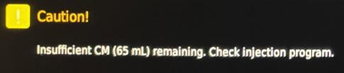
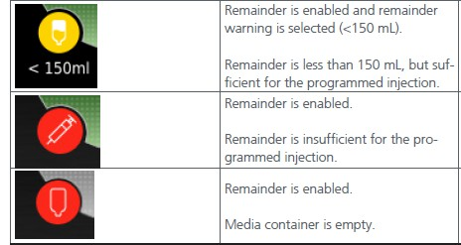
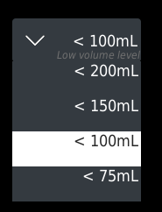
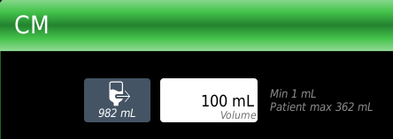
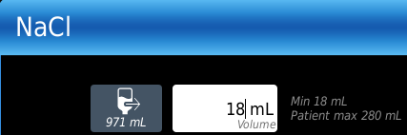
Easy-to-understand remaining volume indication
  Warning message still appears at touch terminal (already available in ≤ SW 6.0.x)
  Plus traffic light indication → warning volume level can be selected in the System Settings
  Plus accurate mL indication (in bolus editor)
Notes:
To improve clarity during setup and injection, Software 7.0 enhances the remaining‑volume display system.
Updates include:
The existing warning message,
A new traffic‑light indicator, configurable within system settings, and
Precise remaining volume shown in milliliters inside the bolus editor.
These enhancements help users monitor contrast levels more accurately throughout each procedure.
This is in addition to Insufficient volume warnings messages based off injection protocol on screen. Sites can now choose the select a warning volume level. By selecting a warning volume level a yellow icon appears when volume in active media reaches the desired warning volume mL’s. Warning volume level can be customized in Setting>System Settings>Options under Remainder. Suggested to set at ,100mL’s.
Also, the visualized of the total mL indication this update allow you to see how mL’s are available.

Slide 4
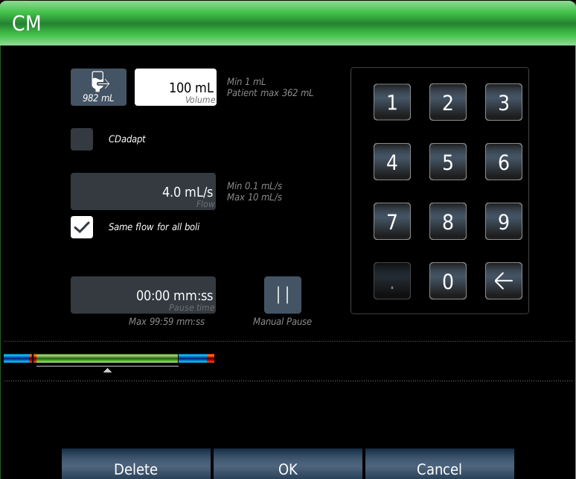
Same flow for all boli
Notes:
Another improvement ensures that all programmed boluses run at the same flow rate.
This creates a more consistent injection profile and supports workflow predictability across multiple bolus phases.
The feature of Same flow for all boli allow user to change the flow rate on one phase across are phases in the injection protocol streamlining the workflow.

Slide 5
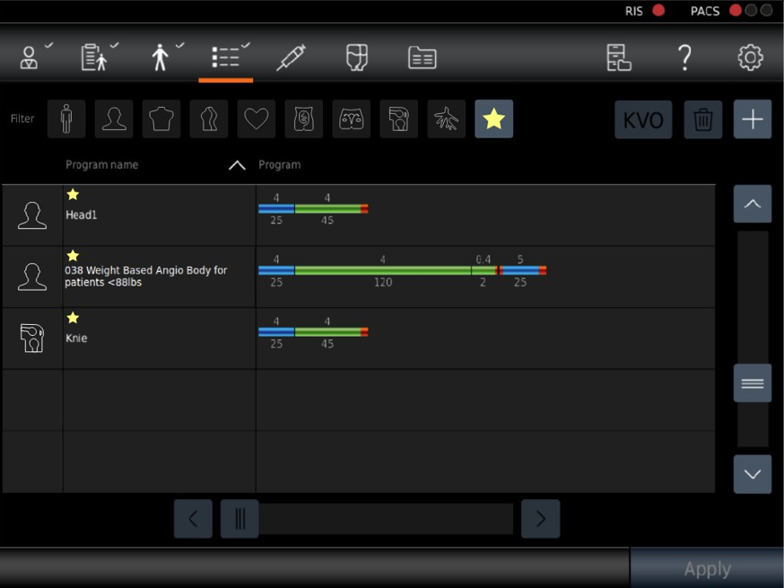
Improved body region icons, filter, and favorites
Notes:
To improve usability, several interface elements have been updated.
Enhancements include:
Clearer body‑region icons
More intuitive filter options
Updated Favorites for quicker protocol access
These changes help streamline navigation and speed up setup time.
The addition of searchable body regions injection protocols can be favored for quicker access.

Slide 6
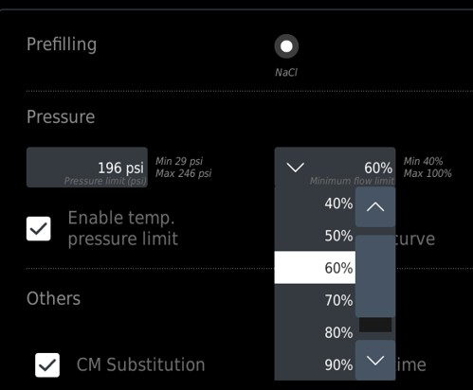
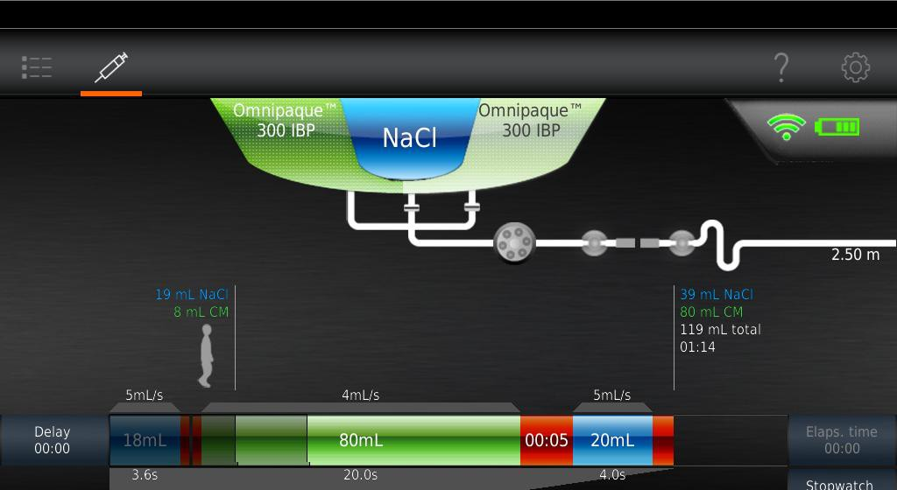
Minimum flow limit setting
  With this setting, a minimum limit can be selected for the flow
  If the pressure limit is reached while an injection is in progress and
  the injector cannot maintain the programmed flow, the pressure
  regulation function is enabled. The consequence of the pressure
  regulation is a reduction of the flow to the selected minimum flow limit
  Value between 40% and 100% can be selected
3.8 ml/s
Notes:
A new minimum‑flow limit setting helps maintain consistent performance during pressure‑regulated injections.
Users can select a minimum flow between 40% and 100%.
If system pressure increases, the injector may reduce flow—but it will not fall below the chosen minimum threshold.
For example, injection protocol set for flow rate of 5mL/sec with a 50% flow limit setting the injector will stop injecting if the flow rate is reduced to 2.5mL/sec.
Option can be set under Setting>Injection Settings>Prefilling/Other Suggested setting of 40% or 50%.

Slide 7
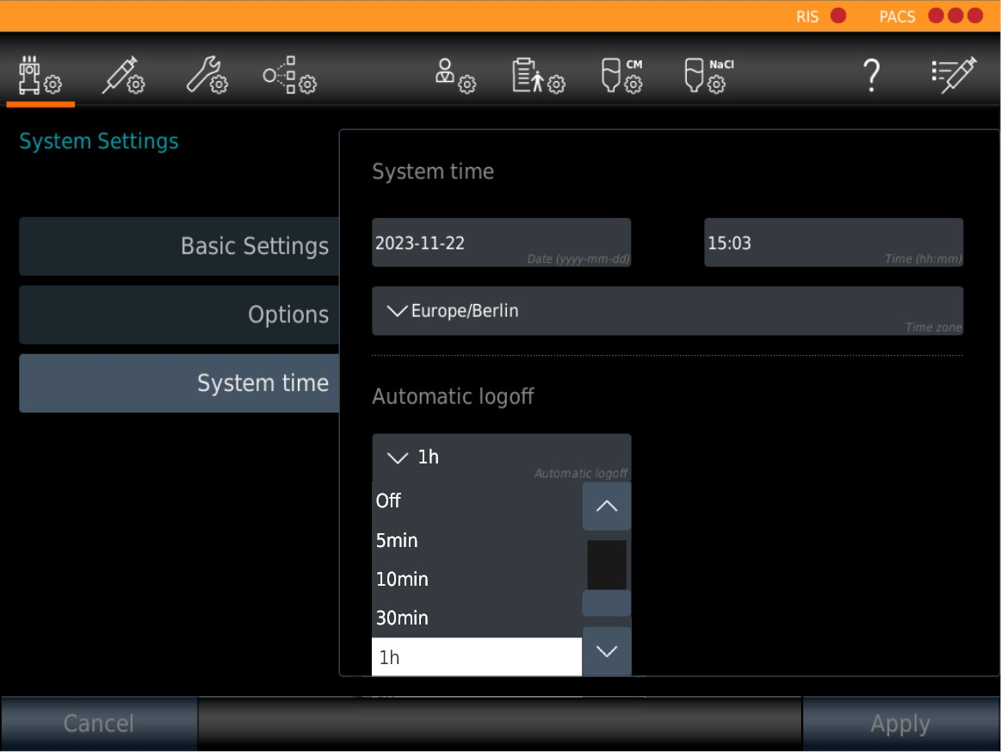
Improvements in RIS/PACs (current customers)
  Password will be displayed during entry
  Selection of longer login periods:
  1h, 2h, 4h, 8h (current logoff after 30 minutes)
Notes:
For current customers, RIS/PACs now includes visible passwords during entry, reducing input errors and extended login durations of 1, 2, 4, or 8 hours.
These updates support smoother workflows and reduce repeated logins.
Sites wishing to extend logoff time must consult site resources to verify a longer logoff time is allow to comply with Cyber security.

Slide 8
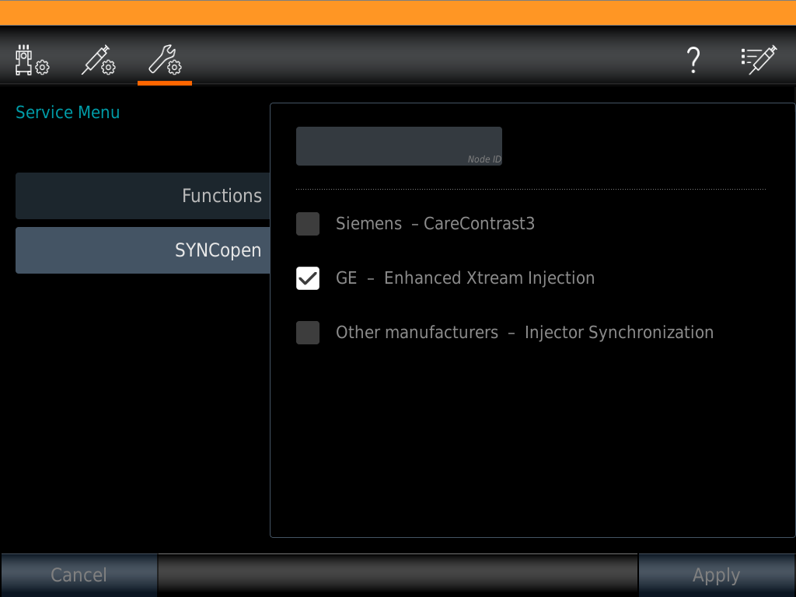
Improvements in SYNCopen (current customers)
  Implementation of “Pseudo idle configuration” → flow and volume can be adapted during manual pause after pre-bolus
Notes:
For current customers, SYNCopen now includes a new pseudo‑idle configuration.
This allows users to adjust flow and volume during a manual pause following the test‑bolus phase. Improvement to workflow.

Slide 9
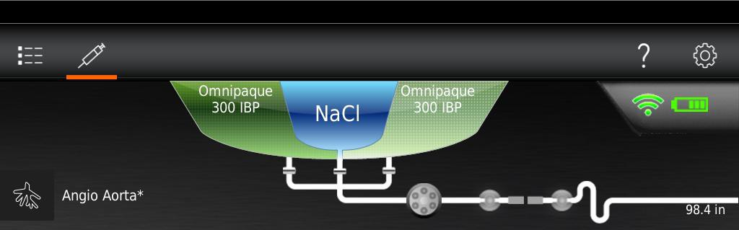
Contrast Media Compatibility
  Omnipaque™ 350 IBP (500 ml)
  Omnipaque™ 350 Single Dose (150 ml)
  Omnipaque™ 300 IBP (500 ml)
  Omnipaque™ 300 Single Dose (150 ml)
  Visipaque™ 320 Single Dose (100 ml, 150 ml)
  Additional:
  ISOVUE 300® IBP (200 ml, 500 ml)
  ISOVUE 370® IBP (200 ml, 500 ml)
Notes:
The update also expands compatibility with additional ISOVUE contrast media formulations.
Newly supported configurations include:
ISOVUE 300 IBP in 200 mL and 500 mL bottles
ISOVUE 370 IBP in 200 mL and 500 mL bottles
These additions give users broader choice in contrast selection and inventory management.

Slide 10
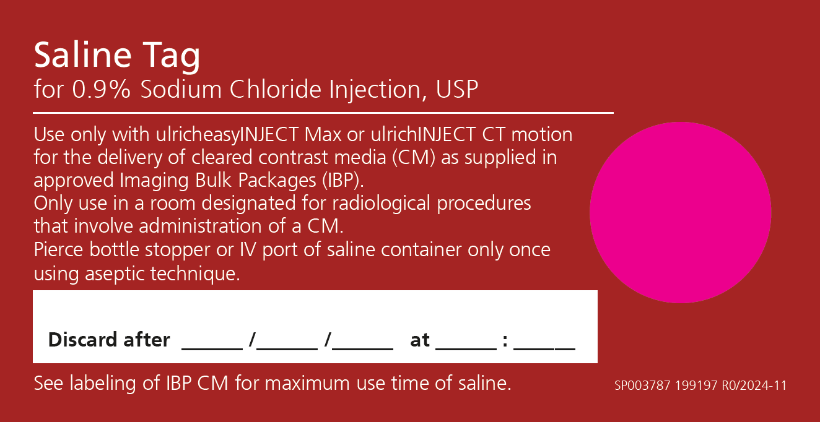
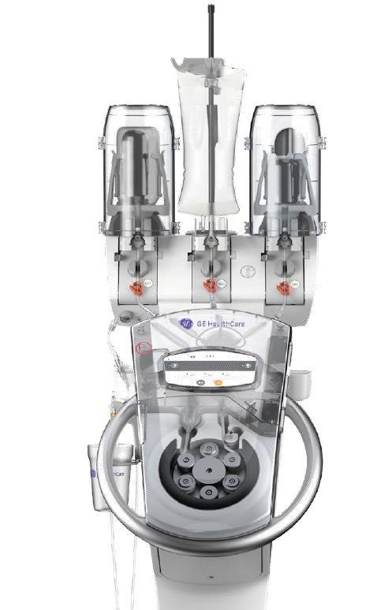
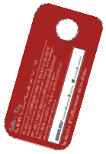
NEW: Saline Tag (Box of 30)
Important
Use time of Saline is linked to use time of CM:
- Omnipaque IBP = 8 hours
- ISOVUE IBP = 10 hours
Notes:
Software 7.0 supports a new Saline Tag, available in boxes of 30.
Saline use time is linked to the associated contrast media - Omnipaque IBP: 8 hours, and ISOVUE IBP: 10 hours.
This update helps ensure proper labeling and compliance with contrast‑media guidelines.

Slide 11
Updated Indications for Use
  CT motion is a contrast media management system that is indicated for the controlled, automatic administration, on the venous side, of contrast media and saline (NaCl), to human subjects undergoing diagnostic examinations in computed tomography (CT) applications.
  CT motion is specifically indicated for use in CT procedures for the delivery of the following contrast media:
  Iohexol Injection in single-dose (SD) container or Imaging Bulk Package (IBP)
  Iodixanol Injection in SD container
  Iopamidol Injection in IBP
  Pump tubing-flex can be used with a maximum of 36 bottles of contrast media or a maximum time of twenty-four (24) hours, whichever comes first.
Notes:
The Indications for Use have been updated to clarify approved applications and disposable‑use guidelines.
CT motion is indicated for controlled, automatic venous administration of contrast media and saline in CT procedures.
Supported contrast types include Iohexol (SD/IBP), Iodixanol (SD), and Iopamidol (IBP).
Pump tubing‑flex may be used for up to 36 bottles or 24 hours—whichever comes first.
Patient tubing is for single‑patient use only.
Spikes are single‑bottle use and must be discarded accordingly.

Slide 12
Protocols
Notes:
Manual entry on this

Slide 13
Thank you!
Notes:
Thank you for your attention in this training. Please reach out to your Sales Professional for more assistance with the 7.0 Software Update.

